Slide 1


Presentation
HOME CREDIT DEFAULT RISK MODELING SERVICE
QINGYUAN WANG, SIYUAN WANG, FLORENCE WANG, ZIFAN QIAN, RICHARD PAN

Slide 2


Presentation
Context
03
Hypothesis
06
Data
08
Model
10
Results
13
Explainability & Validity
15
Conclusion & Next Steps
16
02
/
10

Slide 3

Presentation
Context
Problem Setting
- Many applicants have thin or non-traditional credit history.
- We need a reliable risk score, not fixed manual rules.
Project Objective
- Rank applicants by default risk to support approve/review/decline decisions.
- Improve credit-loss control while maintaining approval throughput.
04
/
10

Slide 4
Presentation
Context
Business Value
- Better ranking helps reduce defaults and improve pricing decisions.
- Explainable outputs support analyst review and governance.
Planning Assumptions
- 100K applications/year, 60% approval, 6% default rate, 45% LGD.
Estimated Annual Impact
- Savings range: $0.52M to $1.17M (policy-dependent).
05
/
10

Slide 5

Presentation
Hypothesis
Working Hypothesis
- Applicant + aggregated credit-history features provide usable risk signal.
Statistical Test
- H0: ROC-AUC <= 0.50 (chance-level ranking)
- H1: ROC-AUC > 0.50 (useful ranking)
Error Trade-off
- False Positive: good borrower blocked -> missed revenue
- False Negative: risky borrower approved -> credit losses
Error Type | Definition | Business Impact
Type I (False Positive) | Classify reliable borrower as high risk | Lost revenue, reduced acquisition, fairness concerns
Type II (False Negative) | Classify high-risk borrower as low risk | Elevated defaults, write-offs
06
/
10

Slide 6
Presentation
Hypothesis
Validation and Governance
- Stratified 80/20 split to preserve class balance.
- Primary metric: ROC-AUC (robust for imbalanced data).
- Early stopping on validation AUC to reduce overfitting.
Decision Policy
- Default threshold = 0.50 (configurable business lever).
- Next step: optimize threshold by expected value and add 5-fold CV.
07
/
10

Slide 7
Data
Presentation
Content | Source | Rows | Columns
Main table with target | application_train.csv | 307,511 | 122
Credit bureau history | bureau.csv | 1,716,428 | 17
Monthly bureau status | bureau_balance.csv | 27M | 3
Prior applications | previous_application.csv | 1.67M | 37
POS/cash loan monthly | POS_CASH_balance.csv | 10M | 8
Payment history | installments_payments.csv | 13.6M | 8
Card monthly balances | credit_card_balance.csv | 3.84M | 23
Data Sources (5.2)
- Main application table + 6 supporting historical credit tables.
- Source scale: ~58M+ rows; modeled at applicant level (307,511 rows).
Feature Engineering (5.4)
- Key ratios: credit/income, annuity/income, credit/annuity, employed percent.
- Per-applicant aggregates: mean, max, min, sum, std, count.
08
/
10

Slide 8
Presentation
Data
Data Exploration and Preparation (5.3, 5.4)
Before
- Heavy missingness (41 columns >50% missing).
- Class imbalance: 8.07% positive class.
After
- Consolidated applicant-level feature set with historical summaries.
- Cleaning: sentinel handling, numeric coercion, missing-category tokens.
- Imbalance handling: LightGBM scale_pos_weight.
09
/
10

Slide 9


Presentation
Model
Model Type (5.9.4)
- Supervised learning
- Binary classification (default vs non-default)
- Algorithm: LightGBM gradient boosting
- Pipeline: preprocessing -> model
Goal: maximize ranking quality for underwriting decisions.
10
/
10

Slide 10

Presentation
Model
Modeling Approach
- Baseline setup -> weighted model -> focal-loss candidate.
- Stratified split: Train 246,008 (80%), Validation 61,503 (20%).
Evaluation
- Primary: ROC-AUC
- Baseline benchmark: random ranking (AUC = 0.50)
- Secondary review at policy thresholds: precision/recall
12
/
10

Slide 11
Presentation
Methodology
Training Setup
- Preprocessing: categorical encoding, numeric coercion, sentinel cleanup.
- Imbalance treatment: scale_pos_weight (~11.39).
- Regularization: subsample, colsample, L1/L2; fixed seed for reproducibility.
- Early stopping on validation AUC.
- Config + metrics tracked in artifacts/training_report.json.
11
/
10

Slide 12


Presentation
Results
Key Results (5.9.5)
- Validation ROC-AUC: 0.7893
- Train ROC-AUC: 0.8936
- Random baseline: 0.5000
- Lift over baseline: +0.2893
Conclusion: model provides strong risk ranking signal.
03
/
10

Slide 13

Presentation
Results
Results by Modeling Phase
- Baseline (random): AUC 0.5000
- Selected model (scale_pos_weight): Validation AUC 0.7893
- Candidate focal-loss model: Validation AUC 0.7886
- External SOTA with identical data/pipeline is not directly available.
Policy Use
- Low risk: auto-approve
- Medium risk: human review
- High risk: decline/stricter terms
13
/
10

Slide 14
Presentation
Explanation
Local Explanation (Per Applicant)
- Method: LightGBM pred_contrib=True
- Output: top contributors, base value, final probability
- Meaning: each feature moves risk score up or down additively
Why It Matters
- Gives analysts clear reason codes per case
- Improves transparency and audit readiness
- Supports consistent approve/review/reject decisions
14
/
10

Slide 15
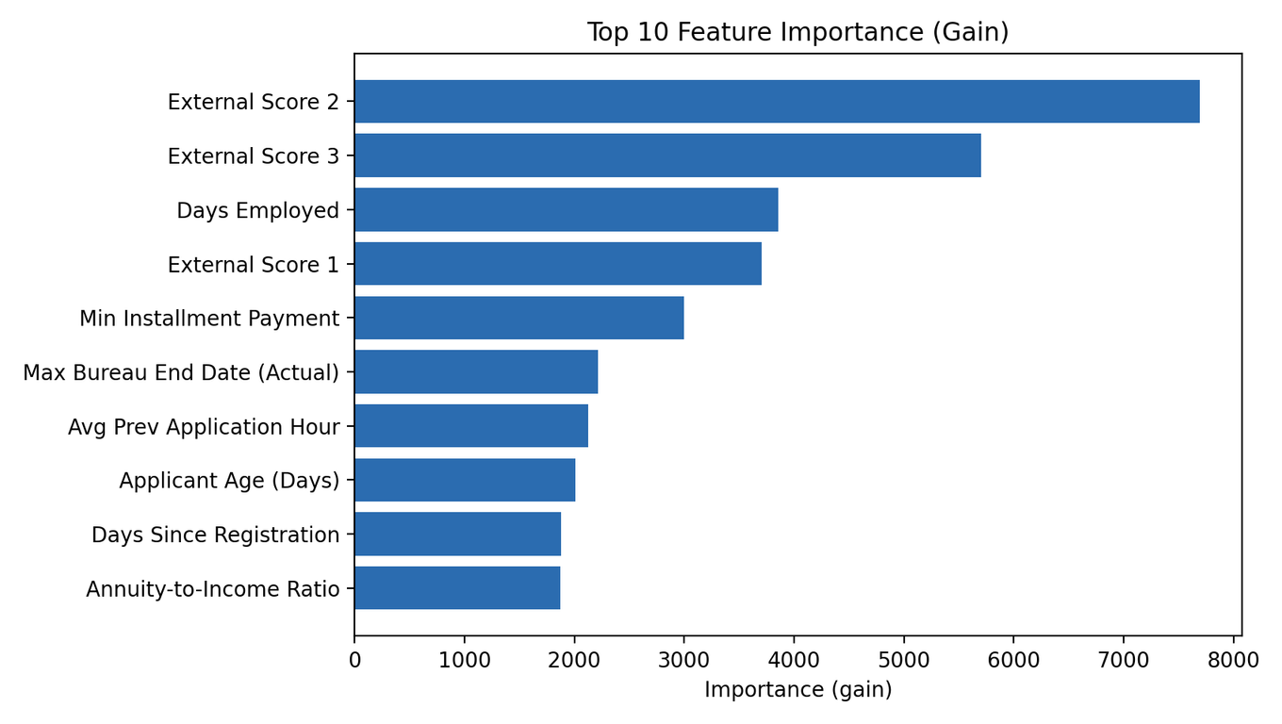
Explanation
Presentation
Global Explanation (Portfolio Level)
- Feature importance captured during training (gain + split)
- Exposed through API: GET /feature-importance?limit=N
- Highlights which signals drive model behavior overall
Governance Benefit
- Track feature-importance shifts across retrains
- Detect drift and potential shortcut learning
- Keep model behavior aligned with risk policy
14
/
10

Slide 16
Presentation
Threats to Validity
Threats to Validity (5.9.7)
- Leakage risk if historical features are not strictly time-aligned.
- Drift risk from economic, policy, or channel changes.
- Missing/unknown values can reduce generalization quality.
- External validity may not transfer to other lenders/geographies.
- Current uncertainty: single holdout evaluation (no CV interval yet).
15
/
10

Slide 17
Presentation
Conclusions
Conclusions (5.9.8)
- Model meaningfully outperforms baseline (0.7893 vs 0.5000 AUC).
- Strong fit for decision-support in underwriting workflows.
Deployment Readiness
- Production API for prediction, metadata, health, and feature importance.
- Local desktop app for analyst use: uv run run-homecredit-local-app.
Recommendation
- Adopt with three risk bands and mandatory human review in the middle band.
- Expected savings potential: $0.52M to $1.17M per year (assumption-based).
Decision Impact
- Proceed with controlled rollout, monitoring, and policy simulation.
- Delaying rollout leaves avoidable default-loss optimization unrealized.
16
/
10

Slide 18
Presentation
LESSONS LEARNED
& NEXT STEPS
- Multi-source aggregation materially improved ranking quality.
- Policy design is as important as model score quality.
- Next: add 5-fold CV and probability calibration.
- Next: implement drift, fairness, and stability monitoring.
- Next: extend local app with scenario simulation for analysts.

